Slide 1
IRON PATRIOTS (4131)
2015 Recycle Rush
Critical Design Review
6 pm Liberty, Room 6105
1/27/2015

Slide 2













4131 Corporate Sponsors
THANK-YOU!

Slide 3
4131 Individual Sponsors
Roy and Mary Thureson
Bradley and Nina Egerstrom
Randall and Synneva Wang
Charles and Kathleen Hobart
Lorie and Evan Adolf
Lennis and Sandra Burt
Phyllis and William Weiss
David Smith
John Smith
Nancy Smith
Mr. and Mrs. Whiteley
Dennis Garrity
Paul and Elise Mullen
THANK-YOU!

Slide 4
Critical Design Review
Introduction and Purpose
Presentation Items Design Lead
Base Alex
Claw Keelan
Conveyer Alex
Control System Austin
Arms Sean & Alex
Elevator Austin
Autonomous Ian
Software Ian
Pit Hayley
Business Cards Sydney
Each topic is expected to be about 10 minutes long

Slide 5
CDR Purpose
Critical Design Review completion indicates that the design concept is sufficiently mature to warrant finalizing the design, ordering parts and assembling the device.
Prototyping of the critical design features should indicate a strong probability that it will work as intended
Electronic modeling should be sufficiently mature that a Bill of Materials can be developed to procure/manufacture parts against
(including nuts and bolts, especially if they’re peculiar)
Software concepts are defined and basic functions are working for all sensors, actuators and devices
Preliminary analysis on weight and balance of the robot, power (electric and pneumatic) consumption and any potential cooling issues have been addressed
Action items for issues that haven’t been addressed

Slide 6

FRC 4131
The Iron Patriots
2015 Base
Alex Chapman

Slide 7
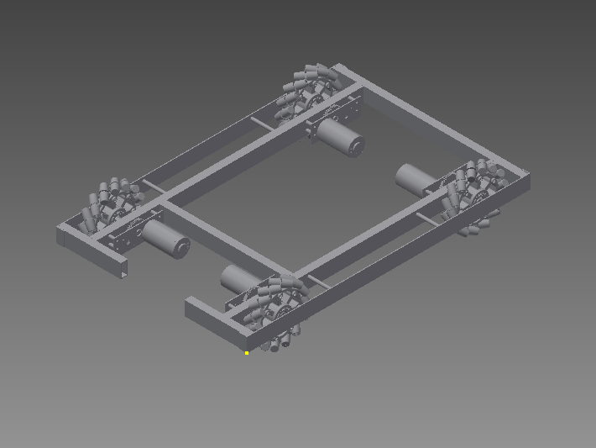
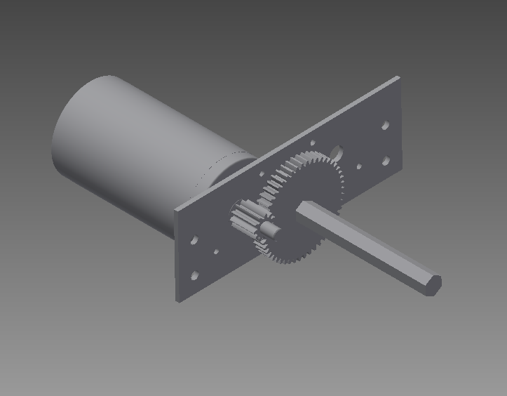
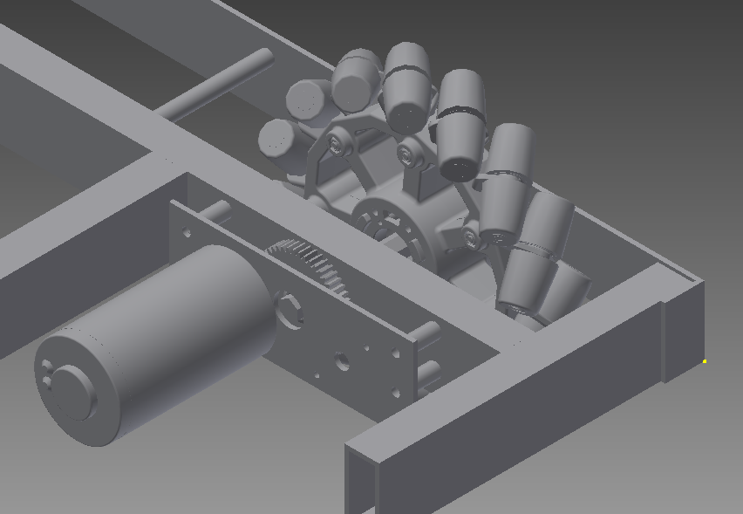
Drive Base
4-Wheel Mechanum Drive
Gearboxes
2x1 boxbeam structure

Slide 8
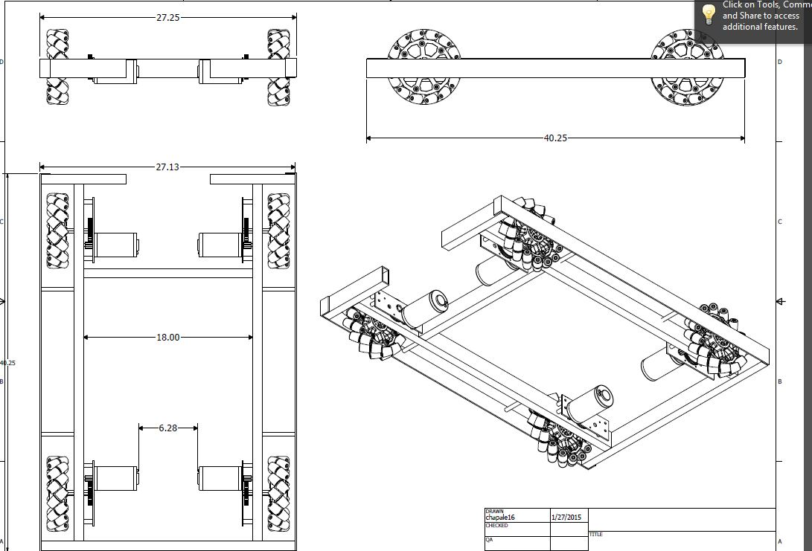

Slide 9
FRC 4131
The Iron Patriots
2015 Claw
Keelan Masterson

Slide 10
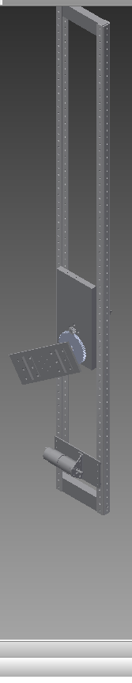
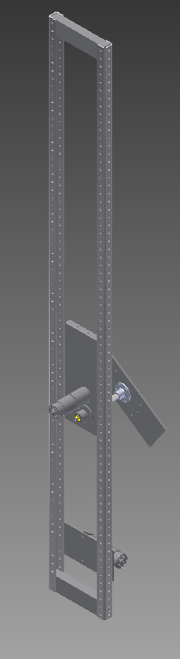

Slide 11
FRC 4131
The Iron Patriots
2015 Conveyor
Alex Chapman

Slide 12
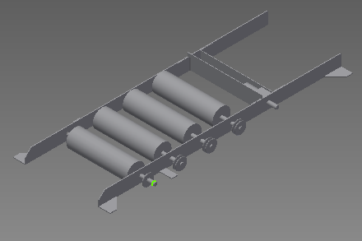
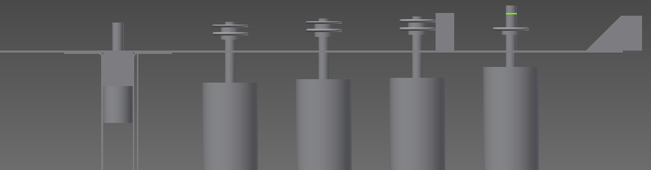
Conveyor Assembly
Chain Drive
#25 Chain
Flanges for structure

Slide 13
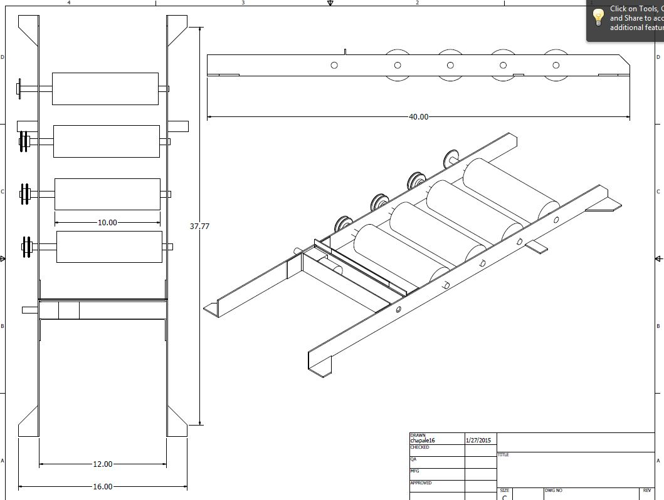

Slide 14
FRC 4131
The Iron Patriots
2015 Control System
Austin Whiteley

Slide 15
Control System
Electronics
Pneumatics
Motors | Motor Controls | Relays | Amp Breaker
Drivetrain | X |  | 40
Drivetrain | X |  | 40
Drivetrain | X |  | 40
Drivetrain | X |  | 40
Collector Arm |  | X | 40
Collector Arm |  | X | 40
Collector Arm |  | X | 40
Collector Arm |  | X | 40
Collector Arm |  | X | 40
Collector Arm |  | X | 40
Collector Pivot | X |  | 40
Collector Pivot | X |  | 40
Elevator | X |  | 40
Claw | X |  | 40
Claw | X |  | 40
Conveyor | X |  | 40
Conveyor | X |  | 40
Total | 11 | 6
Pistons | Solenoids
claw | x
claw | x
elevator | x
elevator | x

Slide 16
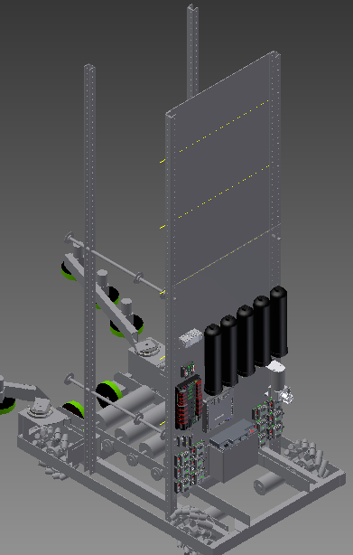
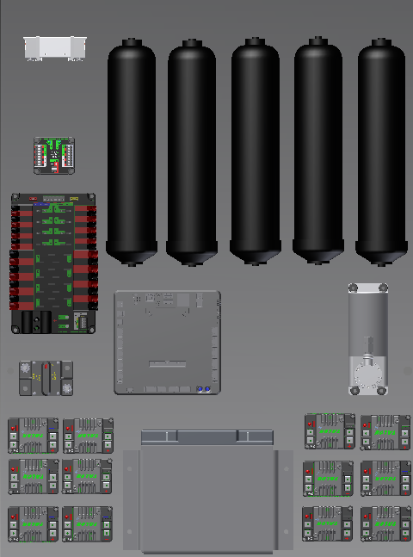
Position On the bot

Slide 17
FRC 4131
The Iron Patriots
2015 Arms
Alex Chapman

Slide 18
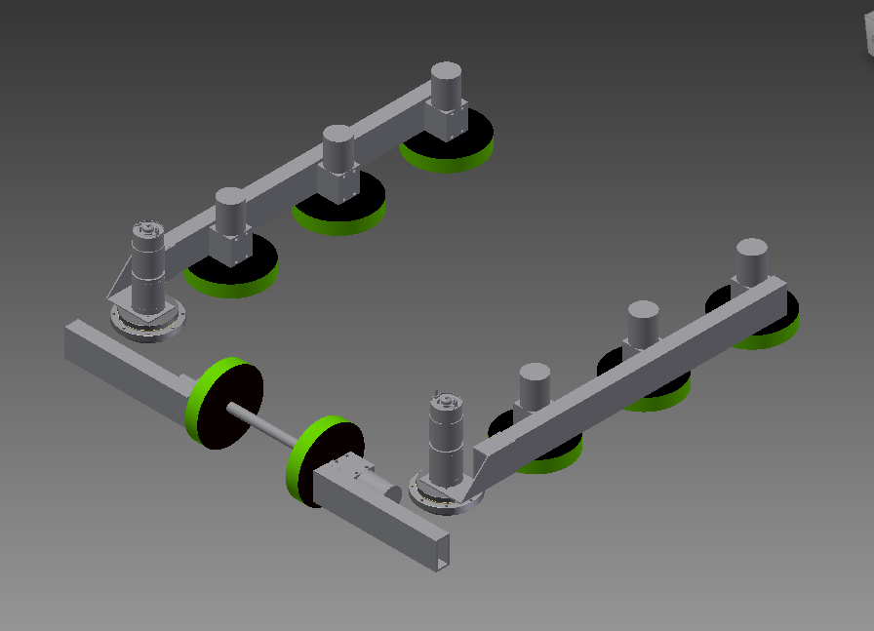
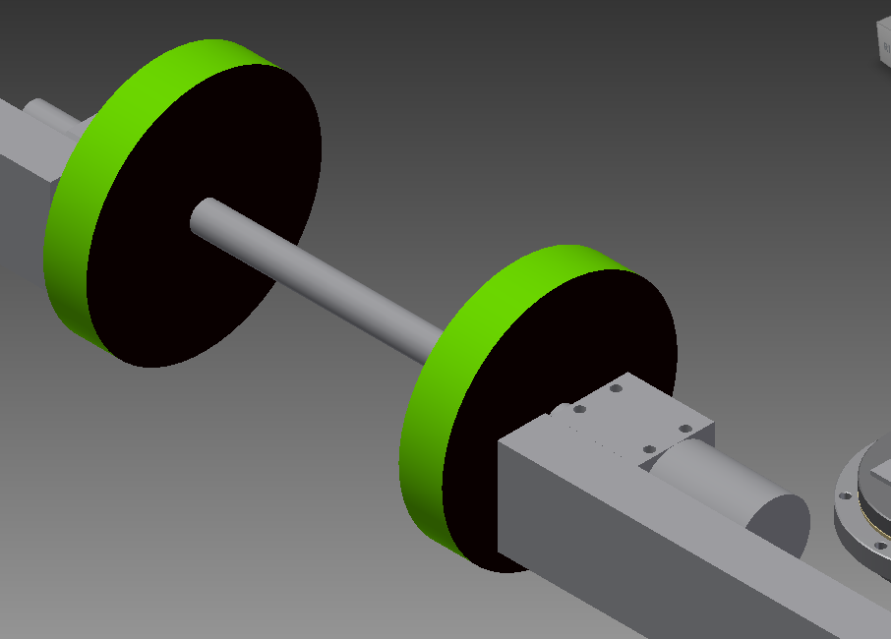
Tote Collector Arms
Motors
Strength
Igus Bearings

Slide 19
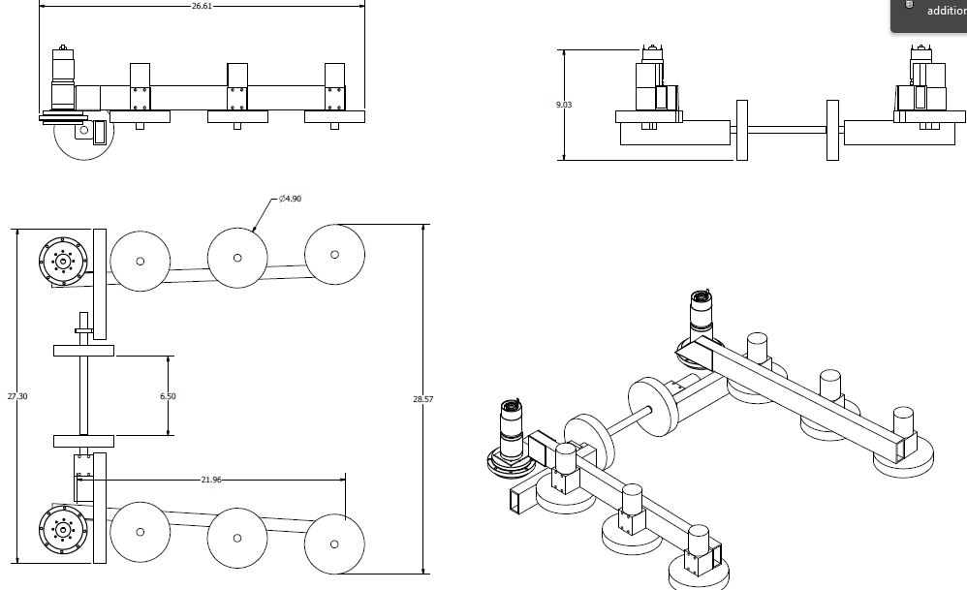

Slide 20
FRC 4131
The Iron Patriots
2015 Elevator
Austin Whiteley

Slide 21
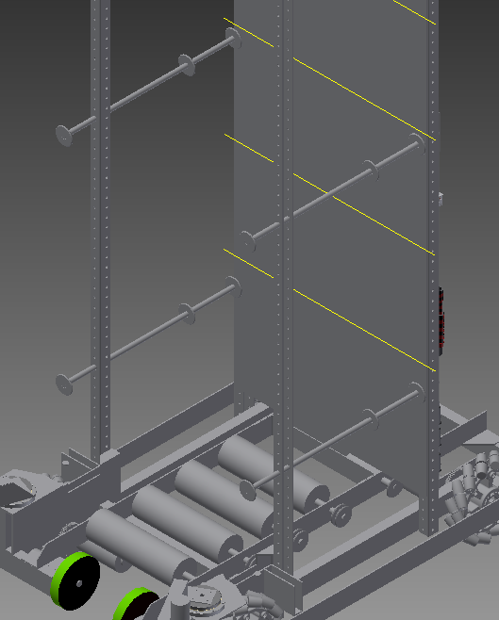
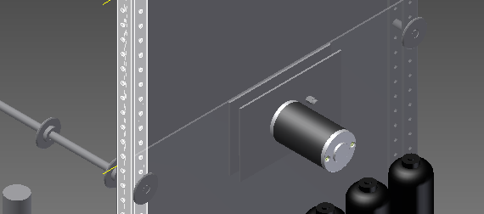
Elevator
Force of motors
Motor Stall Torque(ft*lb) | radius of Sprocket(ft) | Force of motor(lb)
16.6 | 0.0625 | 265
 | 0.0833 | 199
Speed of Chain
Free spin Speed (RPS) | Inches of chain/Rotation
1.25 | 4.712 | 5.89
 | 6.283 | 7.85375

Slide 22
FRC 4131
The Iron Patriots
2015 Autonomous
Ian Weiss

Slide 30
FRC 4131
The Iron Patriots
2015 Software
Ian Weiss

Slide 31
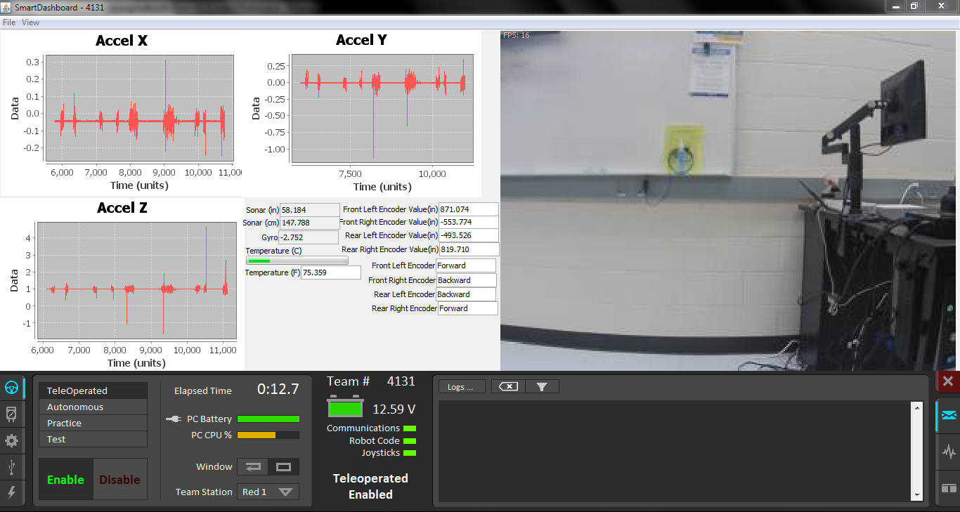

Slide 32
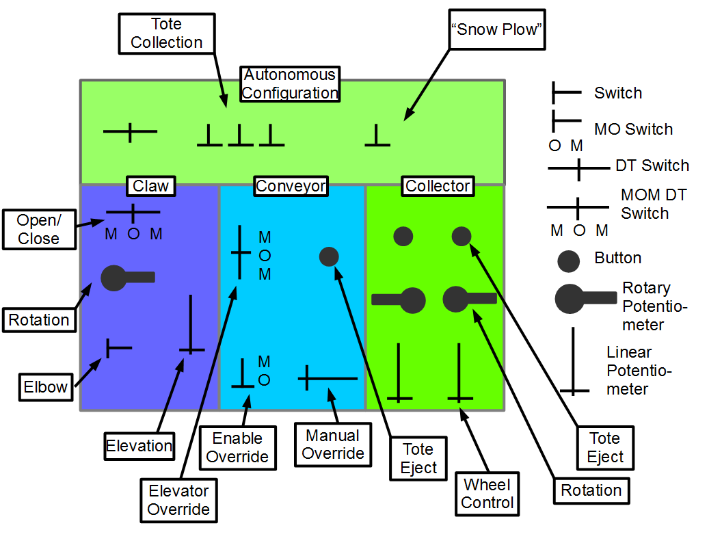

Slide 33
FRC 4131
The Iron Patriots
2015 Pit
Hayley Masterson

Slide 34
FRC 4131
The Iron Patriots
2015 Design and Branding
Sydney Dybing

Slide 35

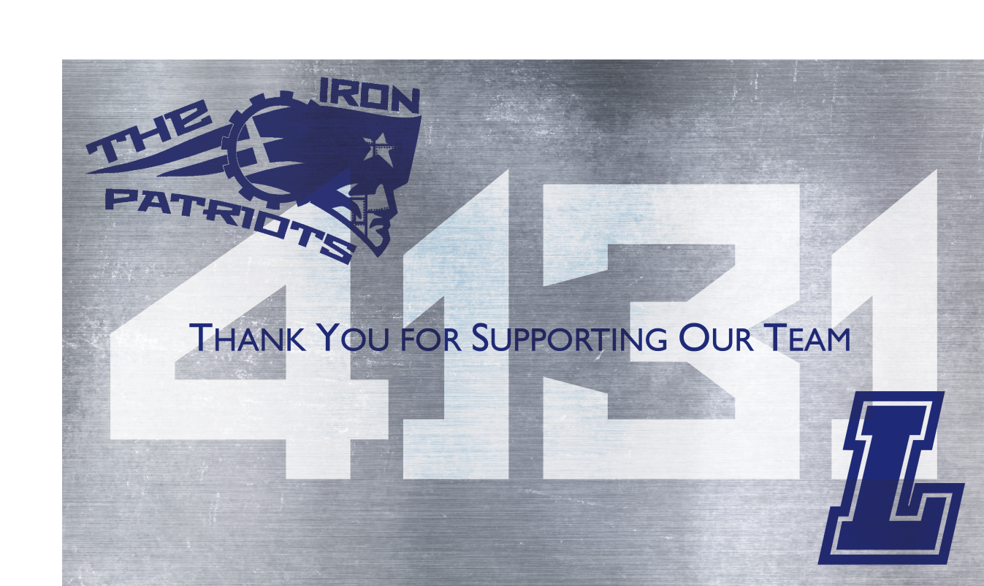

Slide 36


